Slide 2
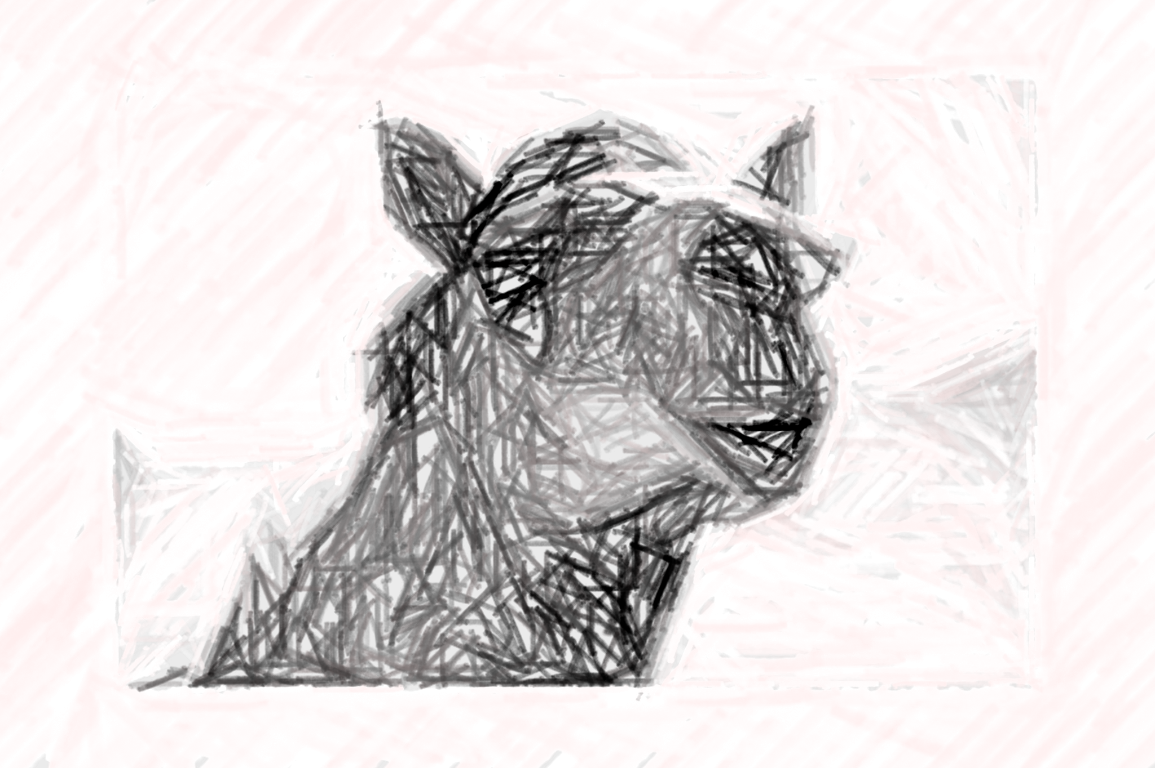
Gnat = tithing 10% of your leaves
Camel = justice, mercy, & faith

Slide 3
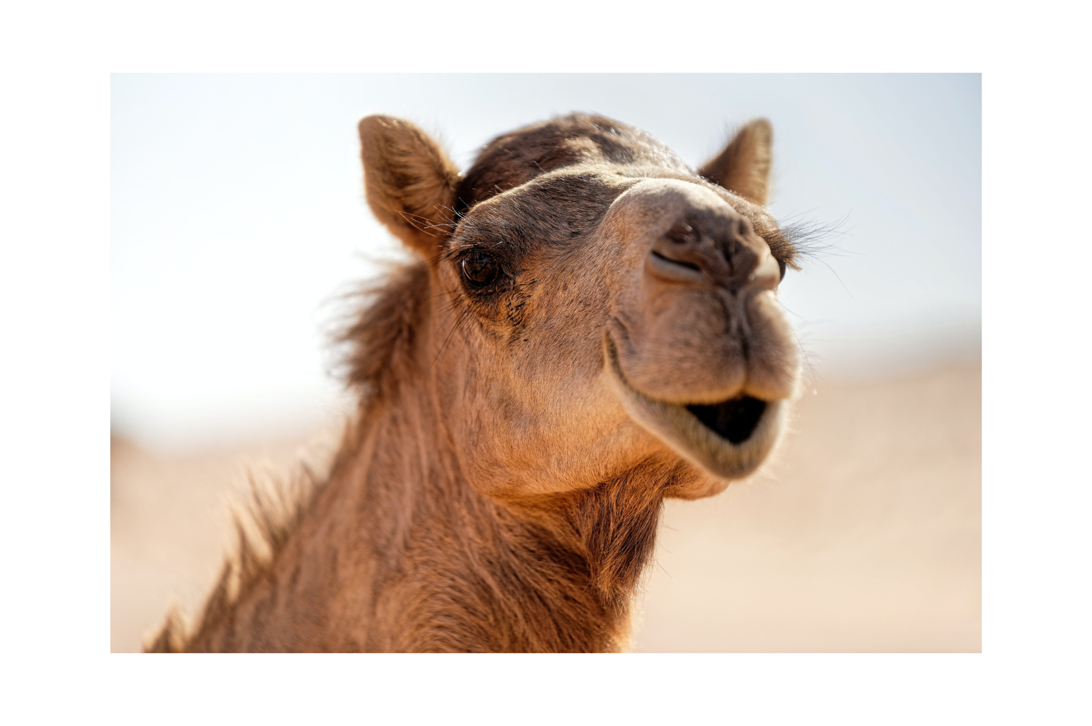
Avoiding
Camels
Justice

Slide 4
Core truths about our World
Blood is blood (Acts 17:26)
Sin affects everybody (Lam. 5:7)
Time and Chance (Eccl. 9:11)

Slide 5
Core Tenets of Justice in the OT
No Partiality (Lev. 19:15)
We reflect God’s value (Ex. 22:21-27, Deut. 24:17-22)
We “do” justice (Is. 1:17, Prov. 21:3, Job. 31:13-23, Ezk. 18:7-9)

Slide 6
Jesus & Justice
Chose to be poor (Lk. 2:24, Lk. 9:58, Is. 53:2)
Sat with the Lowly (Jn 4, Lk. 15:1-2)
Rebuked the “Blessed”
“For you know the grace of our Lord Jesus Christ, that though He was rich, yet for your sakes He became poor, that you through His poverty might become rich” -2Cor.8.9

Slide 7
Reflection Checklist
Who’s in my neighborhood?
What’s my corner?
Who’s my Onesimus?
Who do I visit in “worship services?”
Will I hug someone who smells?
Be like Jesus: do justice.

